Slide 1


EXPLORATORY
DATA ANALYSIS
OF
SPOTIFY DATA TRACKS
Gourav Mahato

Slide 2


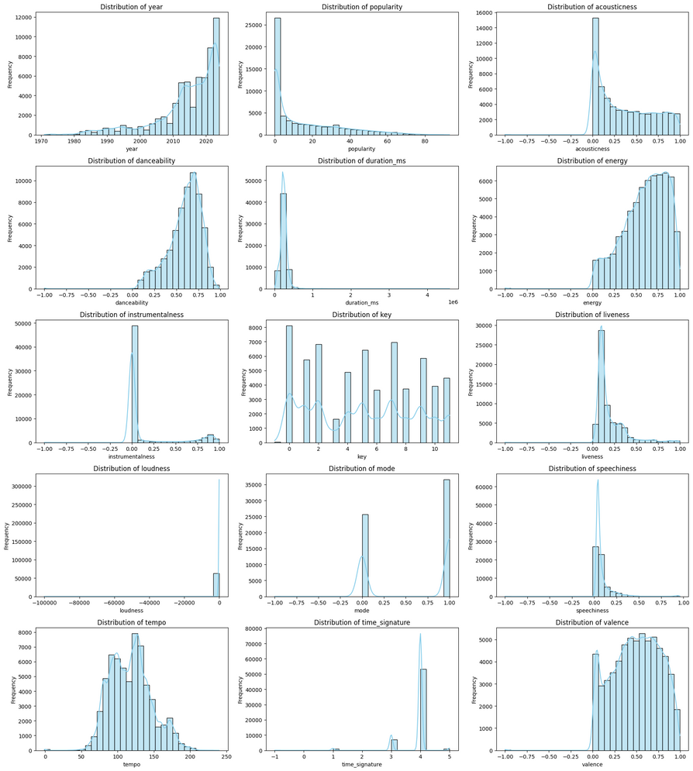

Technical / Musical Feature Observations
Recency Bias: The dataset is heavily dominated by music released around 2020 and later.
Upbeat Majority: Most tracks are high in Energy and Danceability (clustered near 0.8 and 0.7, respectively).
Vocal and Studio-Centric: The vast majority of songs are not instrumental, not live, and not speech-heavy (peaks at 0.0 for Instrumentalness, Liveness, and Speechiness).
Standard Traits: Tracks primarily use the 4/4 Time Signature and show a strong preference for the Major Mode (1.0).
Low Median Popularity: Popularity is highly skewed, meaning most tracks have very low scores.

Slide 3
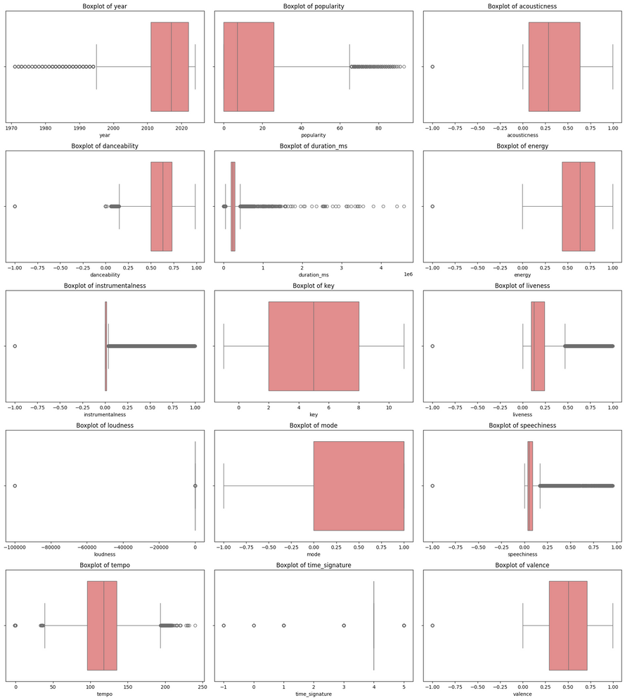
Central Tendency and Spread
Recent Music: The data is heavily concentrated in the most recent years ($\approx$ 2017-2021).
Upbeat and Energetic: The majority of tracks are high in Energy and Danceability.
Studio Recordings: Songs are predominantly vocal, non-instrumental, and not live recordings (medians for Instrumentalness, Liveness, and Speechiness are near 0.0).
Major Preference: There is a clear bias towards music in the Major Key Mode (1.0).
Outliers Define Extremes: While median Popularity is low, there are many highly popular outliers, and Duration is mostly short with outliers for very long songs.
Balanced Mood: Valence (mood) is evenly distributed around the $\mathbf{0.5}$ median, indicating a balance of positive and negative-mood tracks.

Slide 4
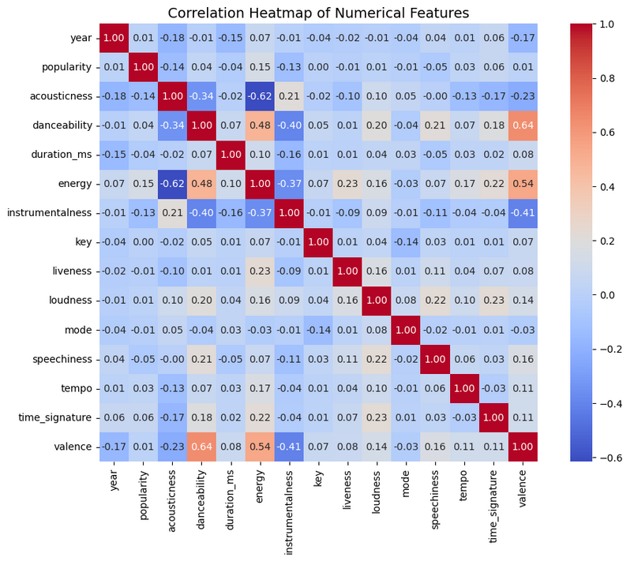
Feature Relationships
Energy and Loudness are Highly Linked: They have the strongest positive correlation (+0.88). Louder songs are highly likely to be more energetic.
Energy Opposes Acousticness: They have a strong negative correlation (-0.62). High-energy songs are typically not acoustic.
Happy Songs are Danceable: Valence (mood/positivity) and Danceability are strongly linked (+0.64).
Acoustic = Instrumental: Acousticness is moderately correlated with Instrumentalness (+0.62).
Recency is Independent: The Year of release has no strong linear relationship (correlations near 0.00) with any other musical feature like popularity, energy, or danceability.

Slide 5

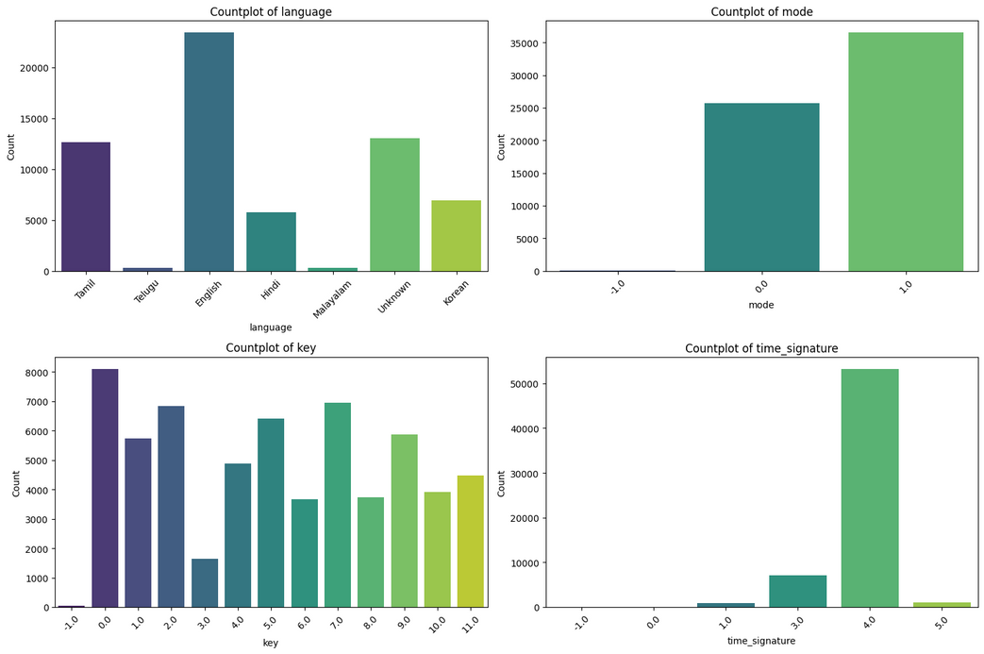
📊 Feature Distributions
Language: English is the most frequent, but the dataset is notably multilingual with significant contributions from Unknown, Tamil, and Korean tracks.
Time Signature: 4/4 time (4.0) overwhelmingly dominates the dataset.
Mode: There is a clear preference for the Major Mode (1.0) over the Minor Mode (0.0).
Key: Key 0 is the most frequent, but the dataset demonstrates a good variety across all 12 keys.

Slide 6
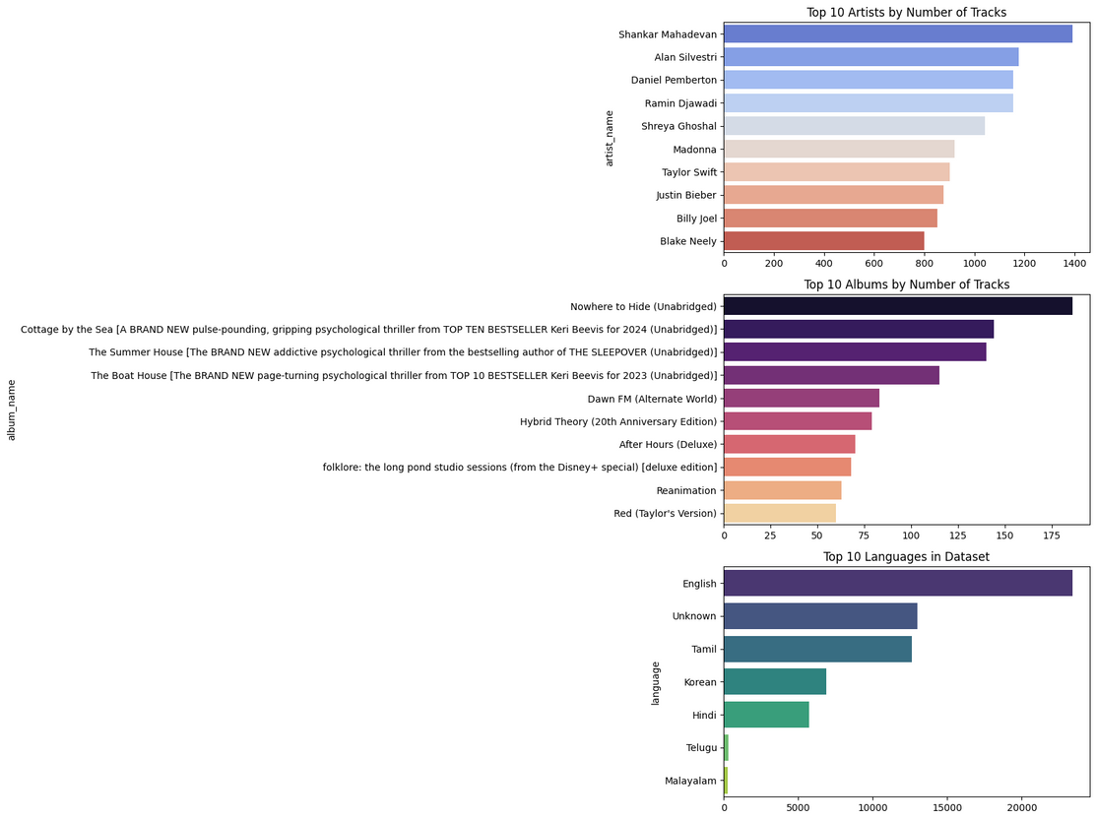
🎤 Top Artists by Track Count
High Track Volume: Artists like Shankar Mahadevan, Alan Silvestri, and Daniel Pemberton have the highest number of tracks (over 1,000 each), suggesting the inclusion of large discographies, soundtracks, or compilation albums.
💿 Top Albums by Track Count
Audiobook/Soundtrack Influence: The top albums are heavily dominated by long-form spoken word content (e.g., "Cottage by the Sea," "Nowhere to Hide," and other unabridged titles), which likely accounts for the high counts in instrumentalness and speechiness seen in other analysis.
🗣️ Top 10 Languages in Dataset
English Leads, but Multilingual: English is the most frequent language (over 20,000), but the dataset shows strong representation from "Unknown," Tamil, and Korean, highlighting a significant non-Western music influence.

Slide 7
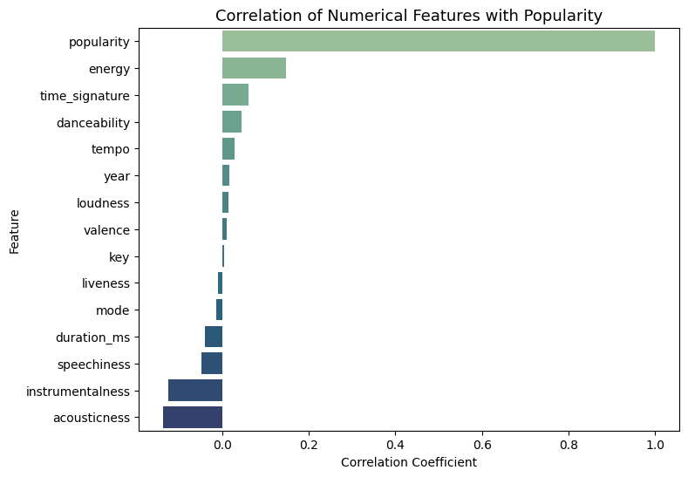
📈 Correlation with Popularity
Strongest Positive Predictor (Energy): Energy has the strongest positive linear correlation with Popularity (coefficient $\approx$ +0.15).
Strongest Negative Predictor (Acousticness): Acousticness has the strongest negative linear correlation with Popularity (coefficient $\approx$ -0.15).
Negative Association with Rawness: Features associated with "raw" music like Instrumentalness and Acousticness both show negative correlations, suggesting popular music is typically less acoustic and less instrumental.
Weak/Negligible Predictors: Most other features, including Loudness, Valence, Key, Liveness, Mode, and Year, have correlation coefficients very close to $\mathbf{0}$, meaning they are poor linear predictors of a song's popularity.

Slide 8

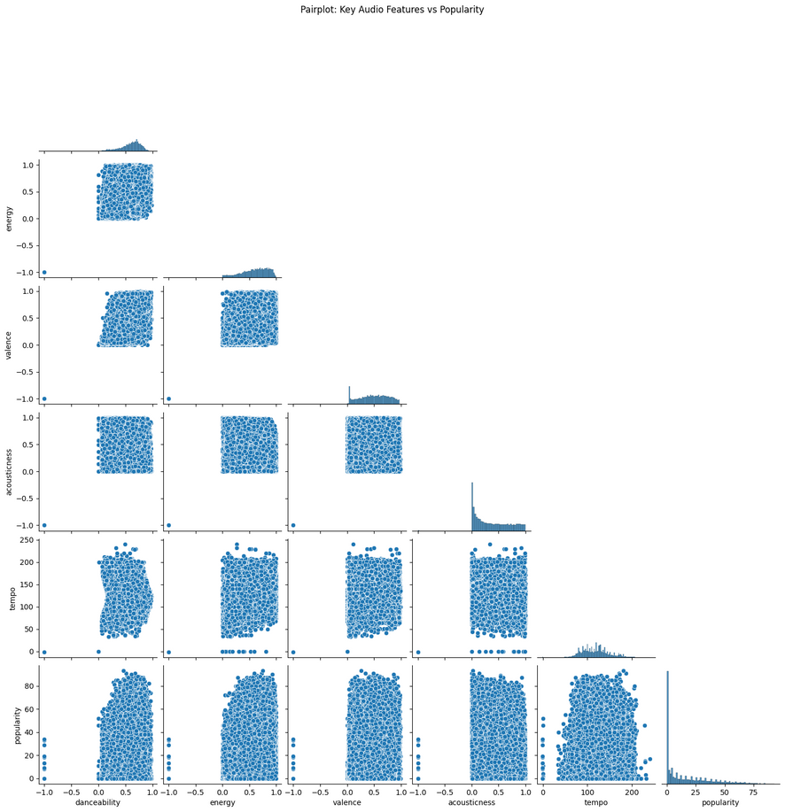
📊 Key Audio Features and Popularity Pairplot Analysis
Popularity is Highly Skewed: The vast majority of tracks in the dataset have very low popularity (close to 0).
Strong Inverse Correlation: There is a clear strong negative relationship between Energy and Acousticness. Tracks that are high in one feature are typically low in the other.
No Strong Correlation with Popularity: None of the individual audio features (Danceability, Energy, Valence, Acousticness, Tempo) show a strong linear correlation with a track's Popularity. This suggests that high popularity is not simply predicted by a high or low value of any single feature.
Broad Feature Distributions: Features like Energy, Valence, and Tempo are generally well-distributed across their possible ranges, meaning the dataset contains a diverse mix of tracks in terms of sound qualities.

Slide 9

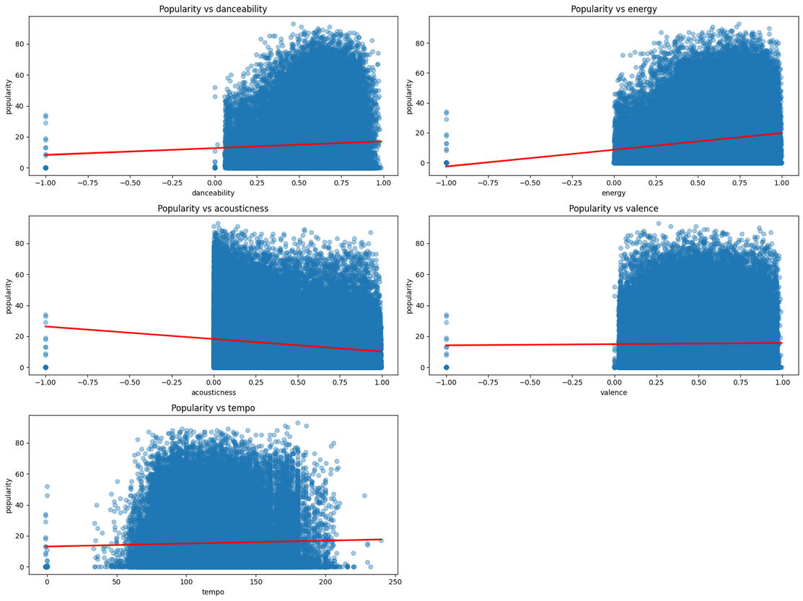
📉 Popularity vs. Audio Features: Weak Linear Correlation Analysis
Weak to No Linear Correlation: The red regression lines are all nearly flat, confirming that there is no strong linear relationship between Popularity and any of the individual audio features (Danceability, Energy, Valence, Acousticness, or Tempo).
Acousticness Shows Weakest Negative Trend: Of the five, only Acousticness shows a slightly perceptible negative slope, but the correlation is still extremely weak.
Popularity Skew: The data is heavily concentrated at the low end of the Popularity axis (0-20), indicating that the vast majority of tracks in the dataset are unpopular, regardless of their audio features.
Features Don't Predict High Popularity: Even tracks with high values for features often associated with hit songs (like high Energy or Danceability) are almost all low in Popularity, proving that no single audio feature can reliably predict high popularity.

Slide 10

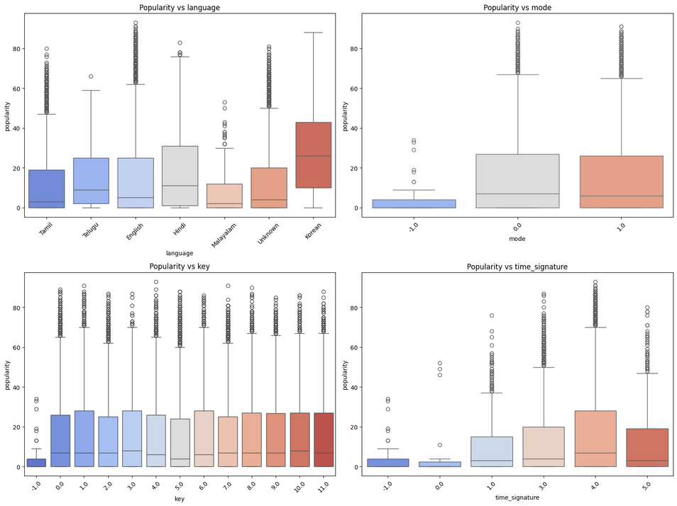
🎵 Popularity Distribution Across Categorical Features (Boxplots)
Language is the Strongest Differentiator: Korean tracks show the highest median popularity and the widest spread among the main language categories, followed by English. Other languages like Tamil and Telugu have very low median popularity.
Mode Matters: Tracks with a defined mode (0.0 or 1.0) have significantly higher median popularity compared to tracks with mode -1.0.
Key is Not Predictive: The median popularity is consistently low across all musical keys (0 to 11), indicating that the key of a song has very little impact on its typical popularity score.
Time Signature 4.0 Dominates: Time Signatures 4.0 and 5.0 are associated with the highest median popularities, while others (like -1.0, 0.0, 1.0) are very low. Since 4.0 is the most common time signature, this suggests typical music structure correlates with typical popularity.
High Outliers are Universal: All categories across all four plots contain numerous tracks with very high popularity scores (outliers), meaning an extremely popular track can exist within any language, mode, key, or time signature.
-

Slide 11
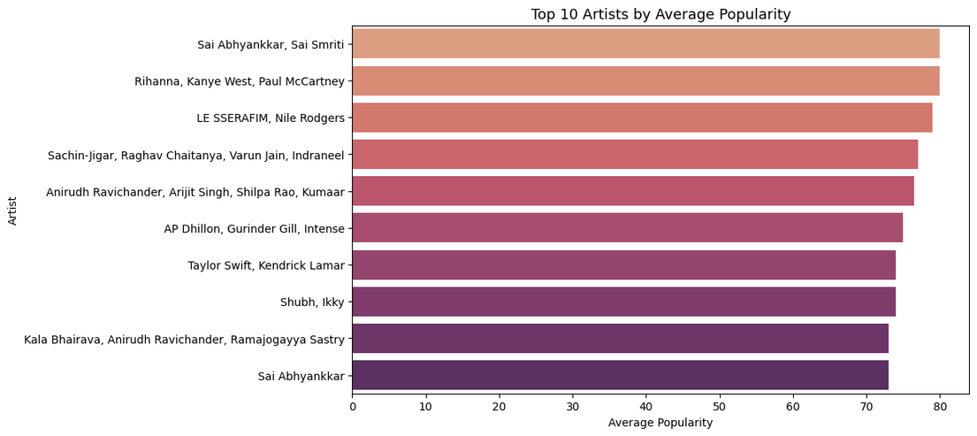
⭐ Top 10 Artists Ranked by Consistently High Average Popularity
Extreme High Average Popularity: All artists listed have an exceptionally high average popularity score, clustered closely between approximately 74 and 80. This indicates that the tracks associated with these artists are
consistently among the most popular in the dataset.
Minimal Ranking Difference: There is a very narrow range (around 6 points) separating the 1st ranked artist/group from the 10th. The difference in average popularity between the top artists is insignificant.
Top Ranked Artist: The group Sai Abhyankkar, Sai Smriti holds the highest average popularity.
Mixture of Global and Regional Artists: The list features globally recognized names (Rihanna, Kanye West, Paul McCartney, Taylor Swift, Kendrick Lamar) alongside artists likely prominent in regional music scenes (Sai Abhyankkar, Anirudh Ravichander), all achieving equally high average scores.

Slide 12
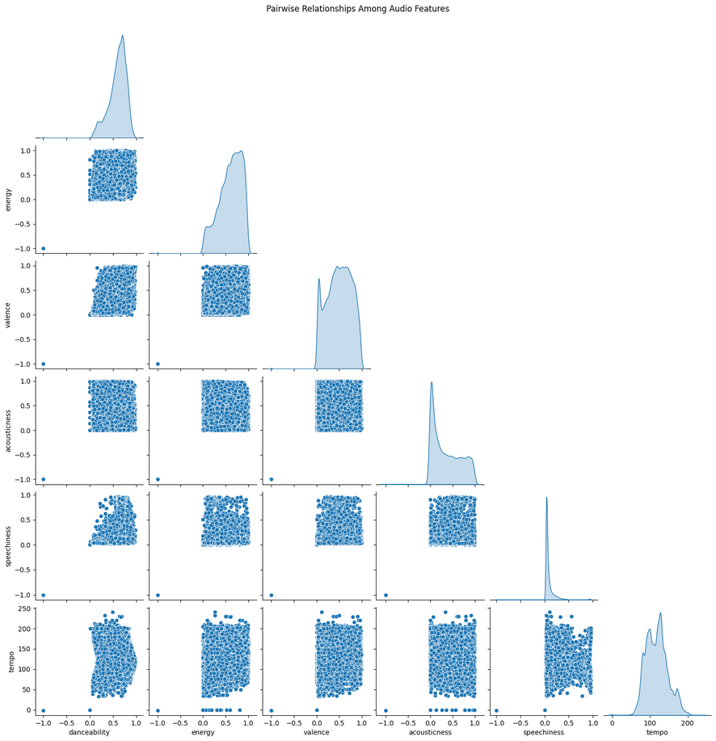
🎼 Pairwise Relationships Among Key Audio Features
Strongest Inverse Relationship: There is a clear strong negative correlation between Energy and Acousticness. Tracks high in one are typically low in the other.
Moderate Positive Relationships: Energy shows a moderate positive correlation with both Danceability and Valence (musical positivity).
Highly Skewed Feature: The feature Speechiness is heavily concentrated at zero, indicating that the vast majority of tracks contain very little spoken word content.
No Clear Correlation: Tempo and Speechiness show no strong linear correlation with any of the other audio features.

Slide 13
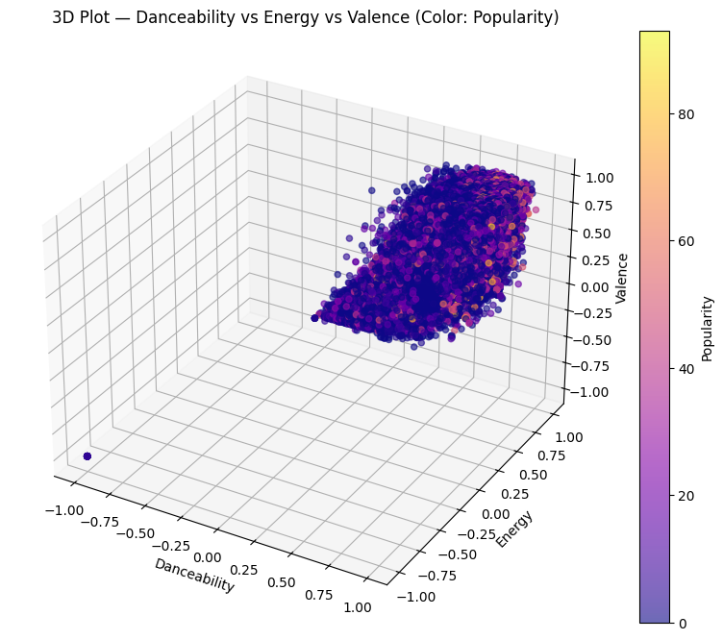
✨ 3D Feature Space: Danceability, Energy, Valence, and Popularity
Strong Positive Feature Correlation: The data forms a tight cluster where high Danceability, high Energy, and high Valence coincide (positive correlation among all three features).
Popularity Concentrated in High-Feature Region: The most popular tracks (yellow/light orange points) are found almost exclusively within this large cluster where all three features are high (above 0.5).
High Features are Necessary, Not Sufficient: The high-feature region (high Danceability, Energy, Valence) is overwhelmingly filled with unpopular tracks (dark blue/purple points). This means high values for these three features are required for a track to be highly popular, but they do not guarantee high popularity.
Low-Feature Tracks are Unpopular: Tracks with low values for these three features are consistently unpopular (dark blue/purple).

Slide 14
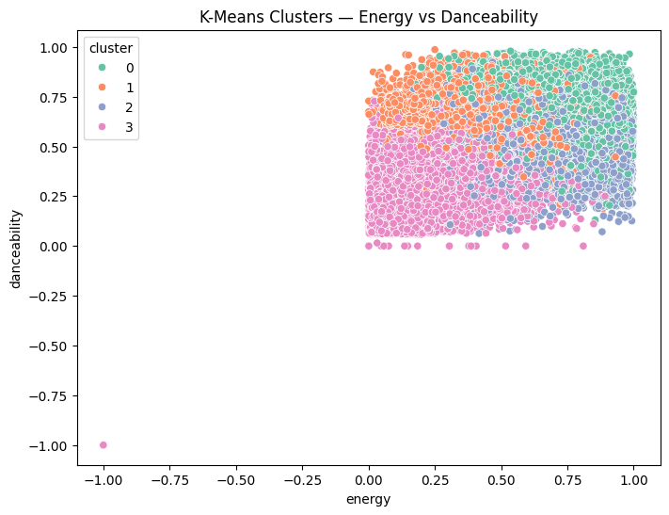
K-Means Reveals Four Distinct Music Segments Based on Energy and Danceability
Four Clusters: The K-Means algorithm segmented the data into four groups (0, 1, 2, 3).
Data Dominance: Most tracks are highly positive, concentrated where Energy and Danceability are between 0.0 and 1.0.
Cluster 0 Focus: Represents the songs that are Highest in both Energy and Danceability.
Feature Difference: Clusters primarily separate songs based on the balance between high energy (Clusters 0, 1, 2) and danceability levels (low for Cluster 3, high for Cluster 0).
Extreme Outlier: One point is isolated near (-1.0, -1.0), representing an extremely non-energetic and non-danceable track.

Slide 15
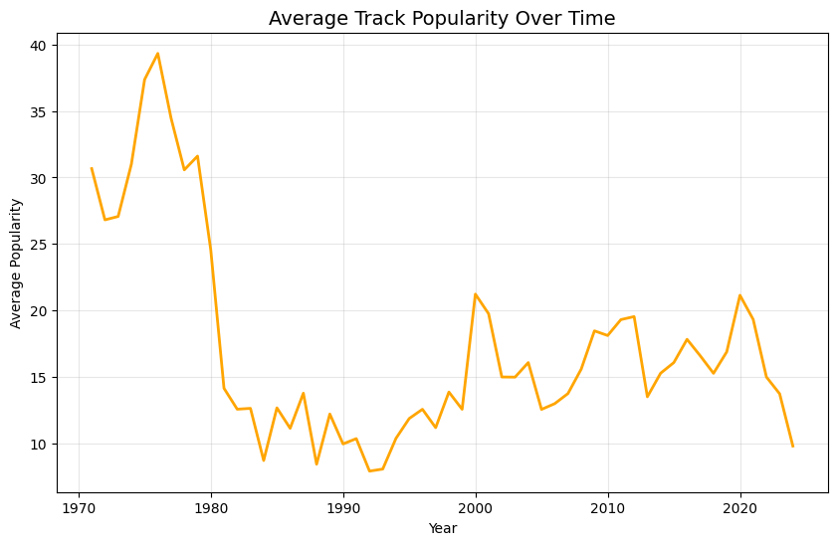
Average Track Popularity Peaked in the Late 1970s Before a Sustained Decline
1978/79 Peak: The average track popularity reached its absolute peak near a score of 40 in the late 1970s.
Post-1979 Crash: A steep and dramatic decline occurred after 1979, with popularity dropping to the low teens by the early 1980s.
Lowest Point: Average popularity hit its lowest sustained level (below 10) around the late 1980s/early 1990s.
Modern Stability: From the late 1990s onward, popularity generally stabilized in the low-to-mid teens (12–20), showing less extreme variation than the earlier decades.
Recent Fluctuation: The data shows a notable rise and recent drop near the end of the timeline (post-2020), returning to a low average.

Slide 16
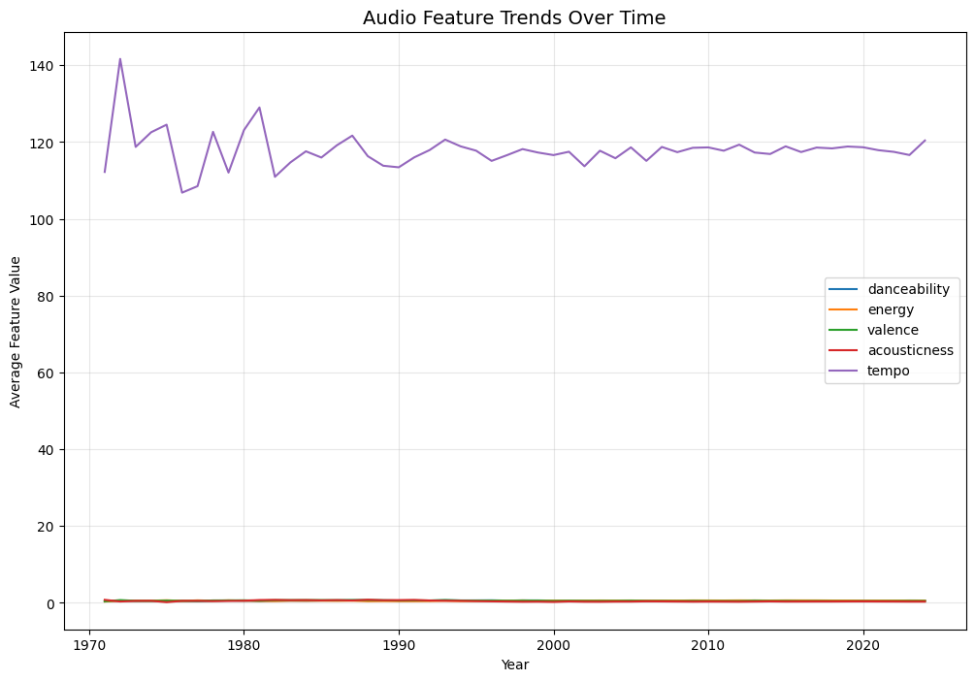
Music Tempo Stabilized Post-1990 After Decades of High Volatility
Tempo Dominance: Only Tempo (BPM) is visible on the high scale (100–140), expectedly measured in different units than the other features.
Low-Value Obscuration: Danceability, Energy, Valence, and Acousticness are clustered near zero, making their actual trends invisible due to the large y-axis scale.
Tempo Volatility: Tempo showed high volatility (large, sharp swings) in the 1970s and 1980s.
Tempo Stability: Since approximately 1990, the average Tempo has become very stable, consistently hovering around 115–120 BPM.
Plot Limitation: The visualization is ineffective for analyzing the four low-value normalized features

Slide 17
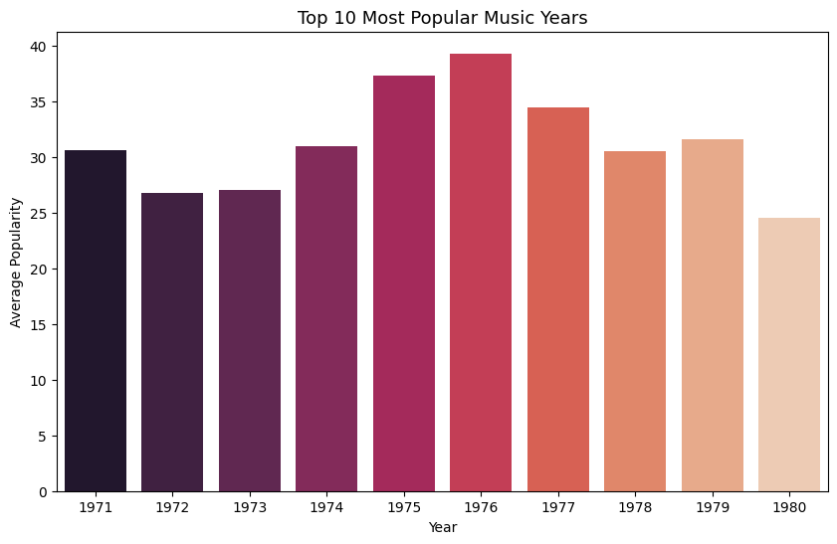
The Mid-1970s, Led by 1976, Account for the Years of Highest Average Music Popularity
1970s Dominance: The top 10 years for average track popularity are almost exclusively the 1970s (1971–1979).
Peak Year: 1976 holds the highest average popularity score, nearly reaching 40.
Secondary Peak: 1975 is the second most popular year, close behind 1976.
Late 70s Decline: There is a clear downward trend in average popularity starting after the 1976 peak, dropping to its lowest point on this chart in 1980 (around 24.5).
High Baseline: All years shown maintained a high average popularity, never dropping below a score of approximately 24.

Slide 18
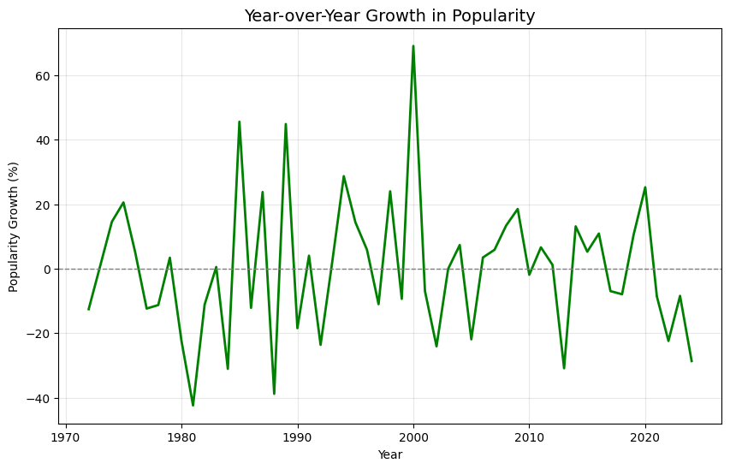
📈 Extreme Volatility in Year-over-Year Popularity Growth
Extreme Volatility: Popularity growth has been highly unstable across the entire 50-year period, with frequent, dramatic swings between high growth and steep decline, ranging from approximately $-42\%$ to $+65\%$.
Highest Growth Peak (2000): The largest single-year growth surge occurred around the year 2000, reaching over 65%.
Steepest Decline (1981): The sharpest decline was around 1981, with popularity dropping by over 40%.
No Long-Term Stability: There is no sustained period of steady, moderate growth; the trend is characterized by constant, massive fluctuations.

Slide 19
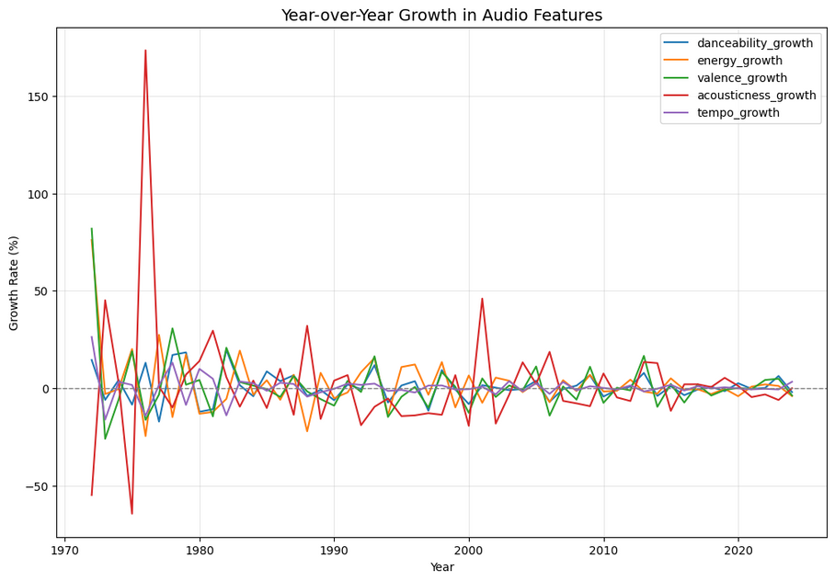
🎶 Year-over-Year Growth of Audio Features
Acousticness is Extremely Volatile: The Acousticness feature (red line) shows massive, extreme fluctuations, peaking near $+175\%$ and dropping sharply during the mid-to-late 1970s.
Other Features are Stable: Danceability, Energy, Valence, and Tempo all show relatively low volatility, with growth rates mostly remaining within the $\pm 30\%$ range throughout the period.
Post-2005 Stability: After the mid-2000s, the growth rate for all five audio features became highly stable and consistent, generally clustering very close to the $0\%$ growth baseline.
Early Instability: The 1970s was the most unstable period, driven primarily by the dramatic swings in Acousticness.

Slide 20
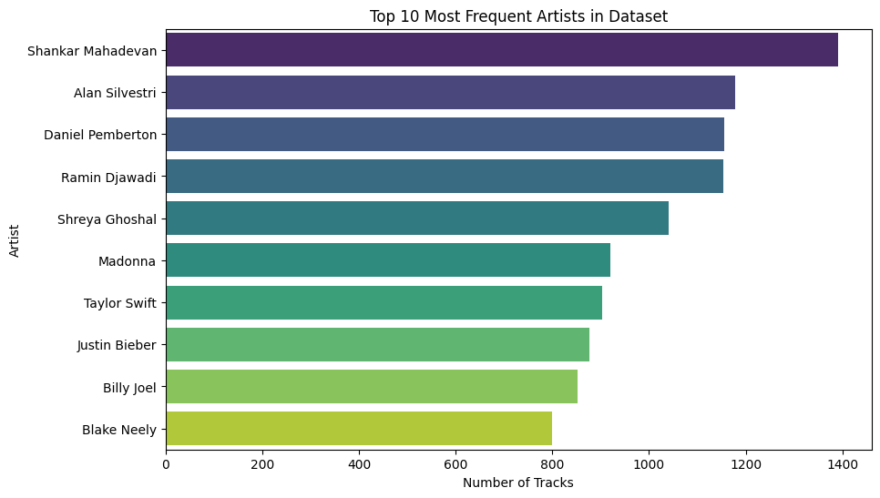
🎤 Shankar Mahadevan Leads Top 10 Most Prolific Artists
Shankar Mahadevan Dominates: Shankar Mahadevan is the most prolific artist, with a track count significantly higher than any other artist (nearly 1,400 tracks).
Clear Top Tier: The top four artists (Shankar Mahadevan, Alan Silvestri, Daniel Pemberton, and Ramin Djawadi) form a dominant group, all having over 1,150 tracks.
Dataset Skew: The high concentration of tracks among a few artists suggests the dataset is heavily skewed towards the work of these individuals, indicating a lack of even distribution across artists.

Slide 21
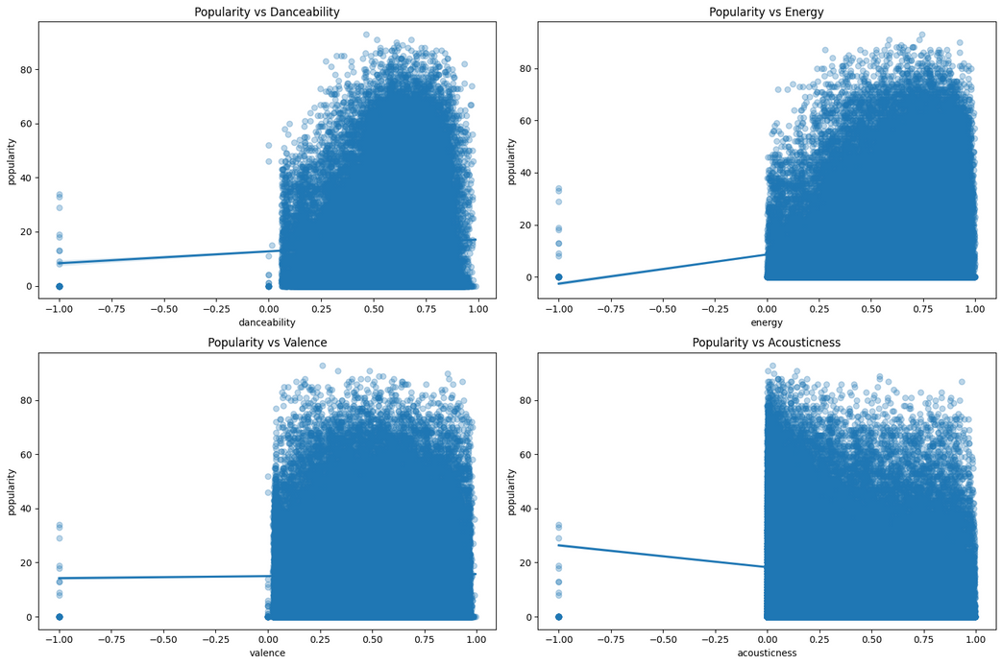
📉 Linear Relationships Between Popularity and Audio Features
No Strong Linear Correlation: The linear regression lines are all nearly flat, confirming that there is no strong linear relationship between a track's Popularity and any of the individual audio features (Danceability, Energy, Valence, Acousticness).
Acousticness Shows Weakest Negative Trend: Only Acousticness shows a slightly negative slope, suggesting a negligible trend where higher acoustic tracks are marginally less popular.
Popularity Skew: The data is heavily concentrated at the low end of the Popularity axis (0-20) across all feature ranges, meaning most tracks are unpopular regardless of their specific sound characteristics.
Features Don't Predict High Popularity: High values for features like Energy and Danceability are overwhelmingly associated with low popularity tracks, proving that high feature scores do not guarantee a popular song.

Slide 22
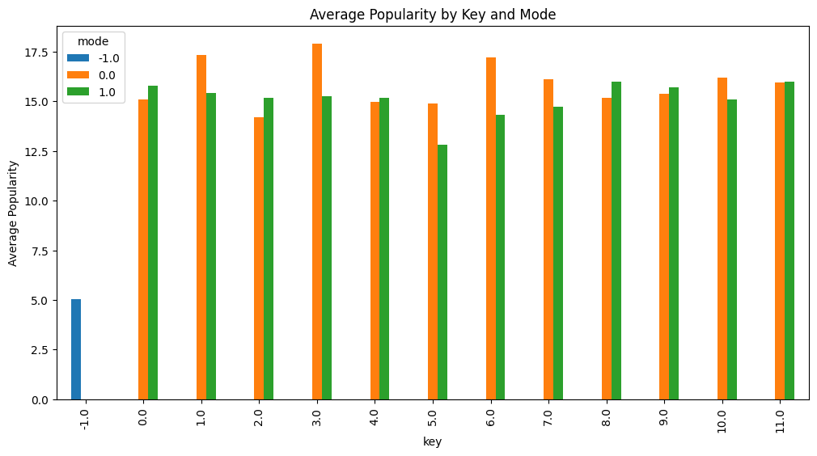
📊 Average Popularity Across Keys and Modes
Key -1.0 is Least Popular: Tracks with an undefined or missing key (Key -1.0) have a significantly lower average popularity (around 5.0) than all other keys.
Key is Not a Major Factor: For all defined keys (0.0 to 11.0), the average popularity is highly consistent (between 14.0 and 18.0), indicating that the specific musical key has only a minor influence on average popularity.
Minimal Mode Difference: The difference in average popularity between minor mode (0.0) and major mode (1.0) is generally minimal across all keys, suggesting modality is not a strong predictor of average popularity.

Slide 23

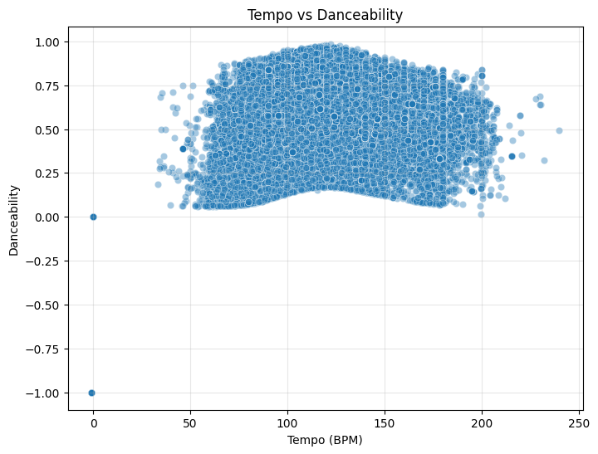
💃 Tempo and Danceability Relationship Analysis
No Strong Linear Correlation: The data forms a scattered cloud, indicating no strong linear relationship between a track's Tempo (BPM) and its Danceability score.
Optimal Tempo for High Danceability: The highest Danceability scores (near 1.0) are achieved only within the common musical tempo range, specifically 75 to 175 BPM.
Danceability Floor: Tracks within the mid-tempo range (75-175 BPM) rarely have very low Danceability, suggesting a minimum threshold for tracks in the common tempo range

Slide 24

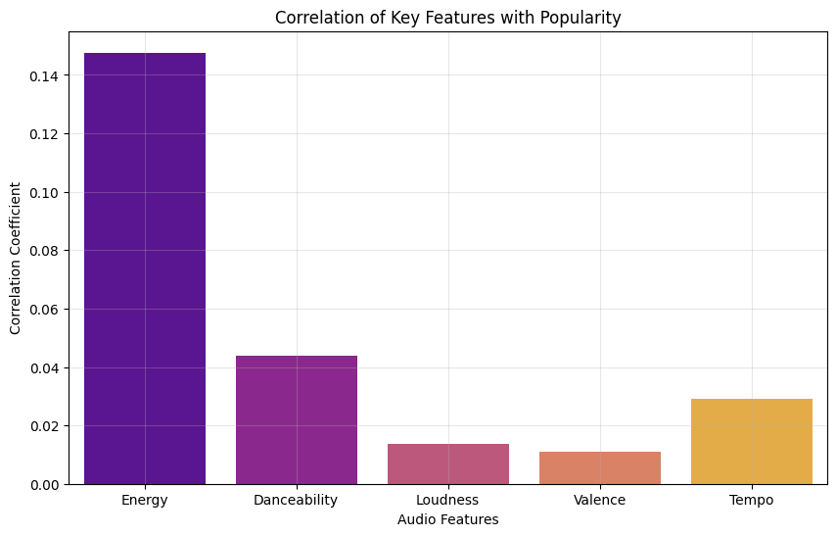
📈 Correlation of Key Audio Features with Popularity
Overall Weak Correlations: The linear relationship between Popularity and all featured audio features is very weak, with no correlation coefficient exceeding $0.15$.
Energy is the Strongest Predictor: Energy has the highest (though still weak) correlation coefficient at approximately $0.148$, making it the strongest single linear predictor of Popularity among this group.
Rank of Predictive Power: The features rank in terms of linear predictivestrength as:
Energy
Danceability (approx. $0.045$)
Tempo (approx. $0.03$)
Loudness $\approx$ Valence (both $\approx 0.01-0.015$)
Loudness and Valence are Negligible: Loudness and Valence have correlations so close to zero that their linear relationship with Popularity is practically negligible.

Slide 25



